Slide 1
Spaceship Titanic Dataset Analysis
Heather Osunga Buyu

Slide 2
Introduction
Goal: Analyze passenger data from the Spaceship Titanic dataset to predict transportation to alternate dimension during collision with spacetime anomaly.

Slide 3
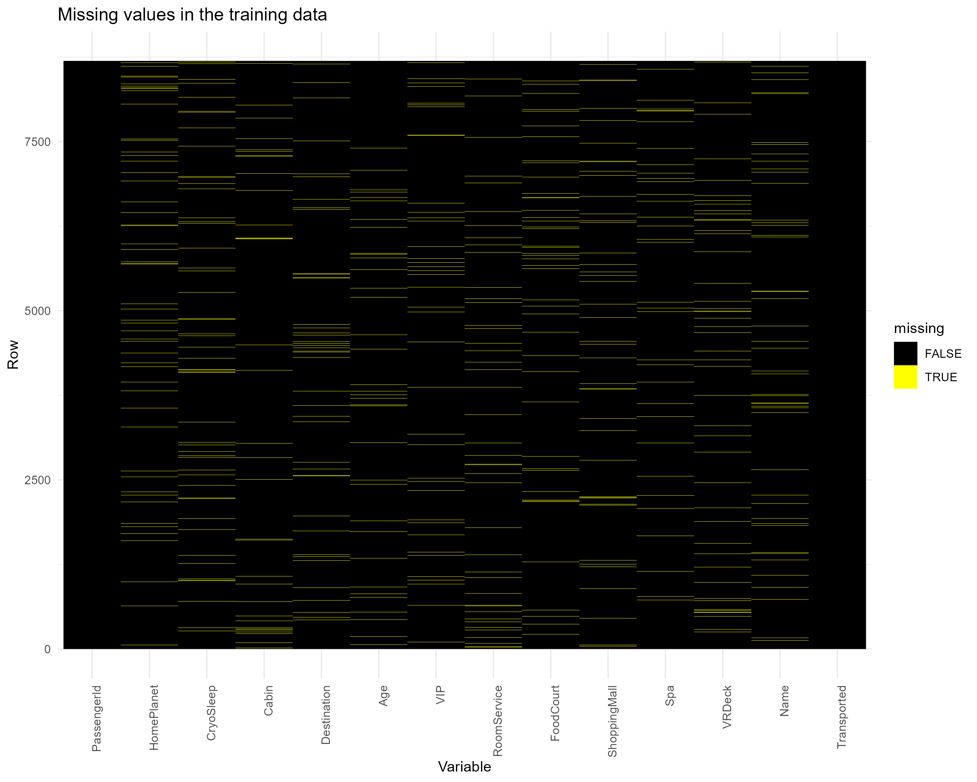
Data inspection and cleaning
Summary of the Data
Missing Values
HomePlanet: 201 missing values
CryoSleep: 217 missing values
Cabin: 199 missing values
Destination: 182 missing values
Age: 179 missing values
VIP: 203 missing values
RoomService, FoodCourt, ShoppingMall, Spa, VRDeck: Around 200 missing values each
Approximately 8700 passengers.
Key columns: PassengerId, HomePlanet, CryoSleep, Cabin, Destination, Age, VIP, RoomService, FoodCourt, ShoppingMall, Spa, VRDeck, Name, Transported

Slide 4
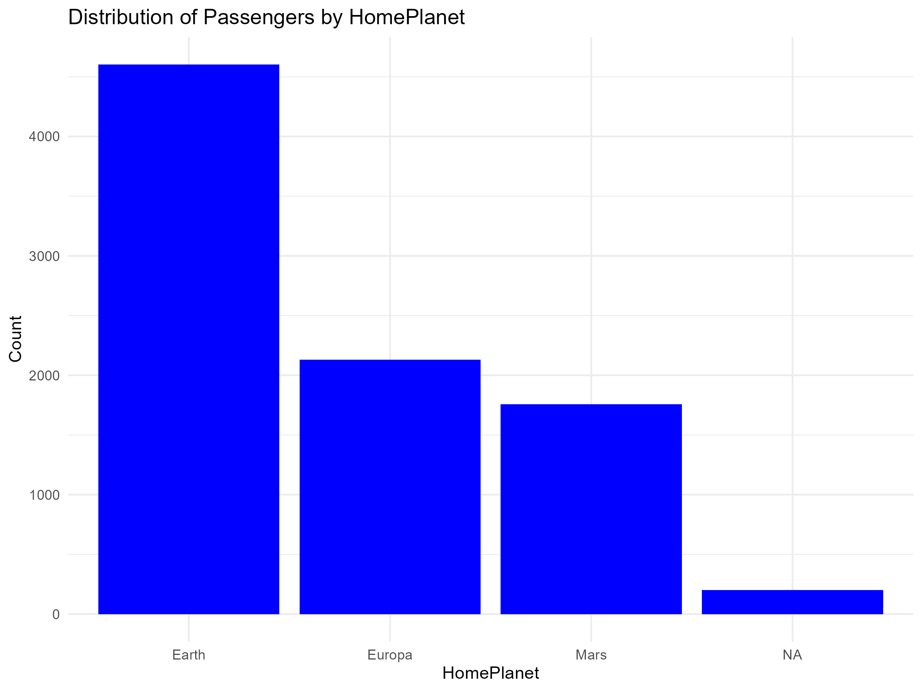
Distribution of Passengers by HomePlanet
The majority of passengers came from Earth, followed by Europa and Mars

Slide 5
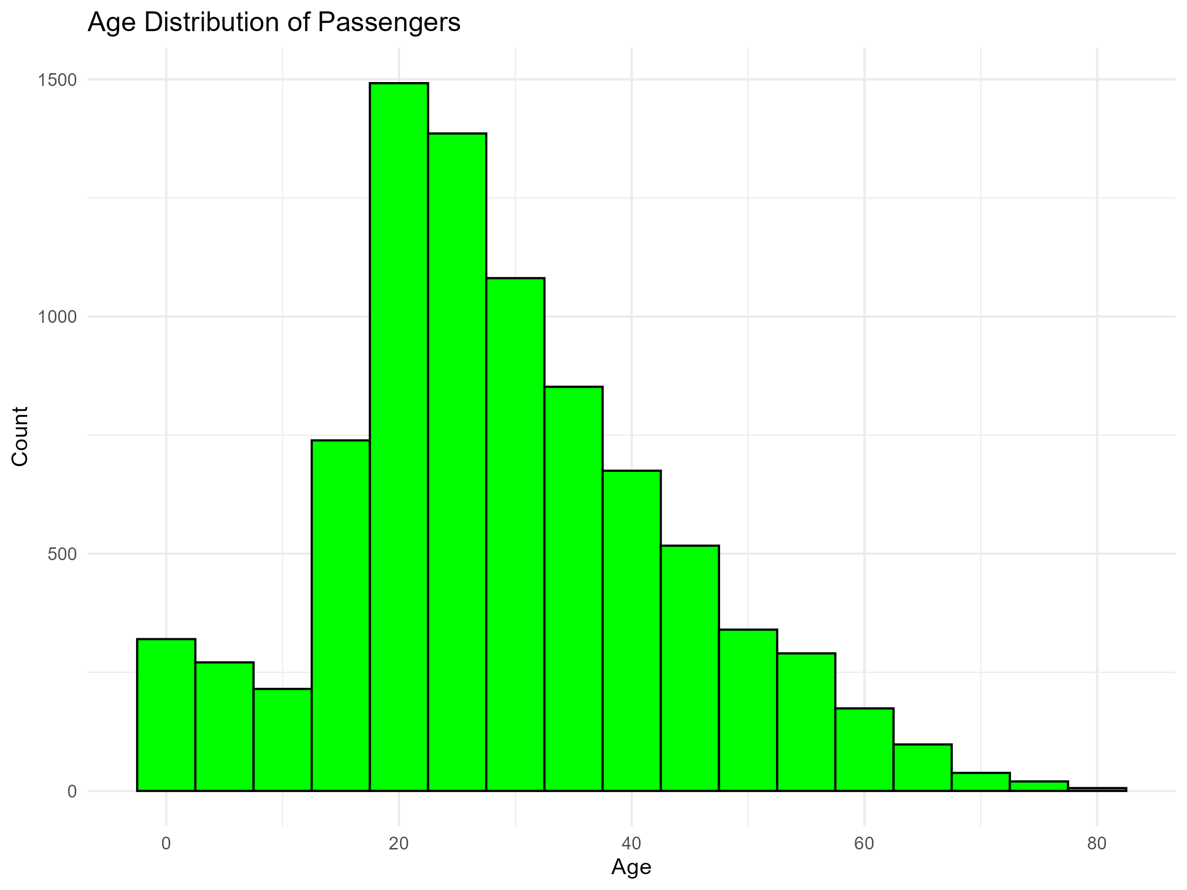
Distribution of passengers by age
The age distribution is relatively uniform, with a slight concentration around younger ages (20-30 years).

Slide 6
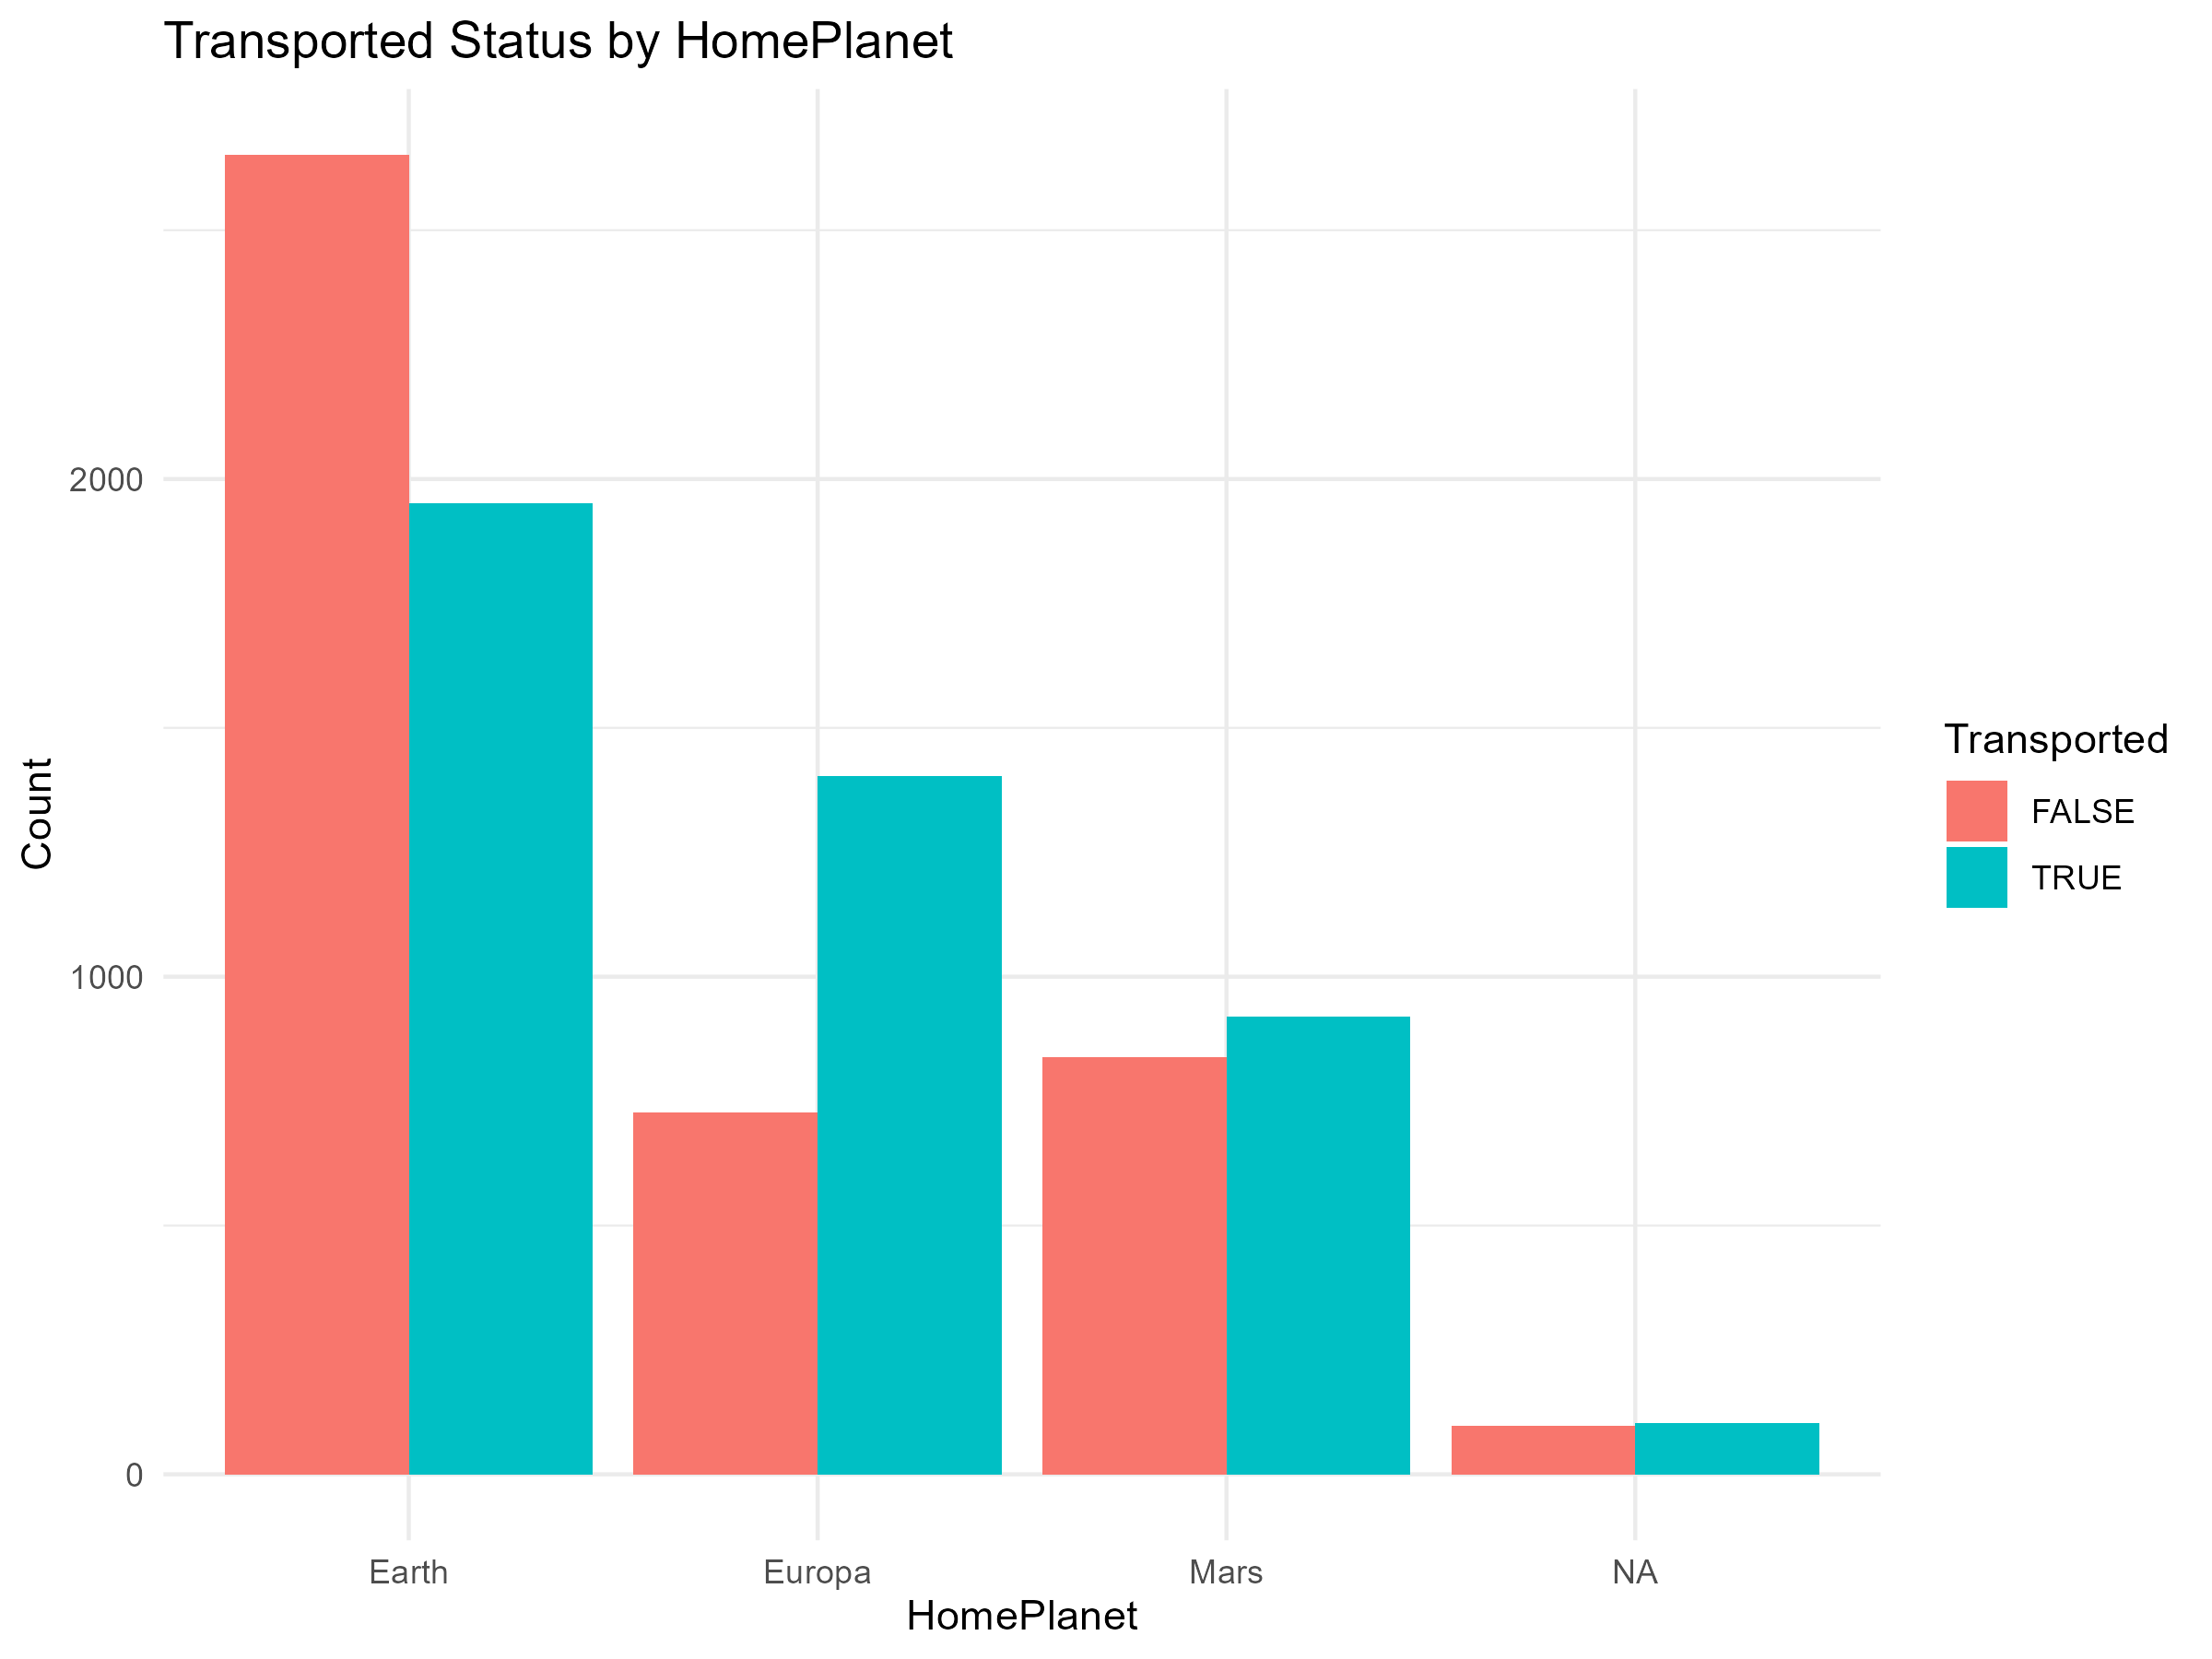
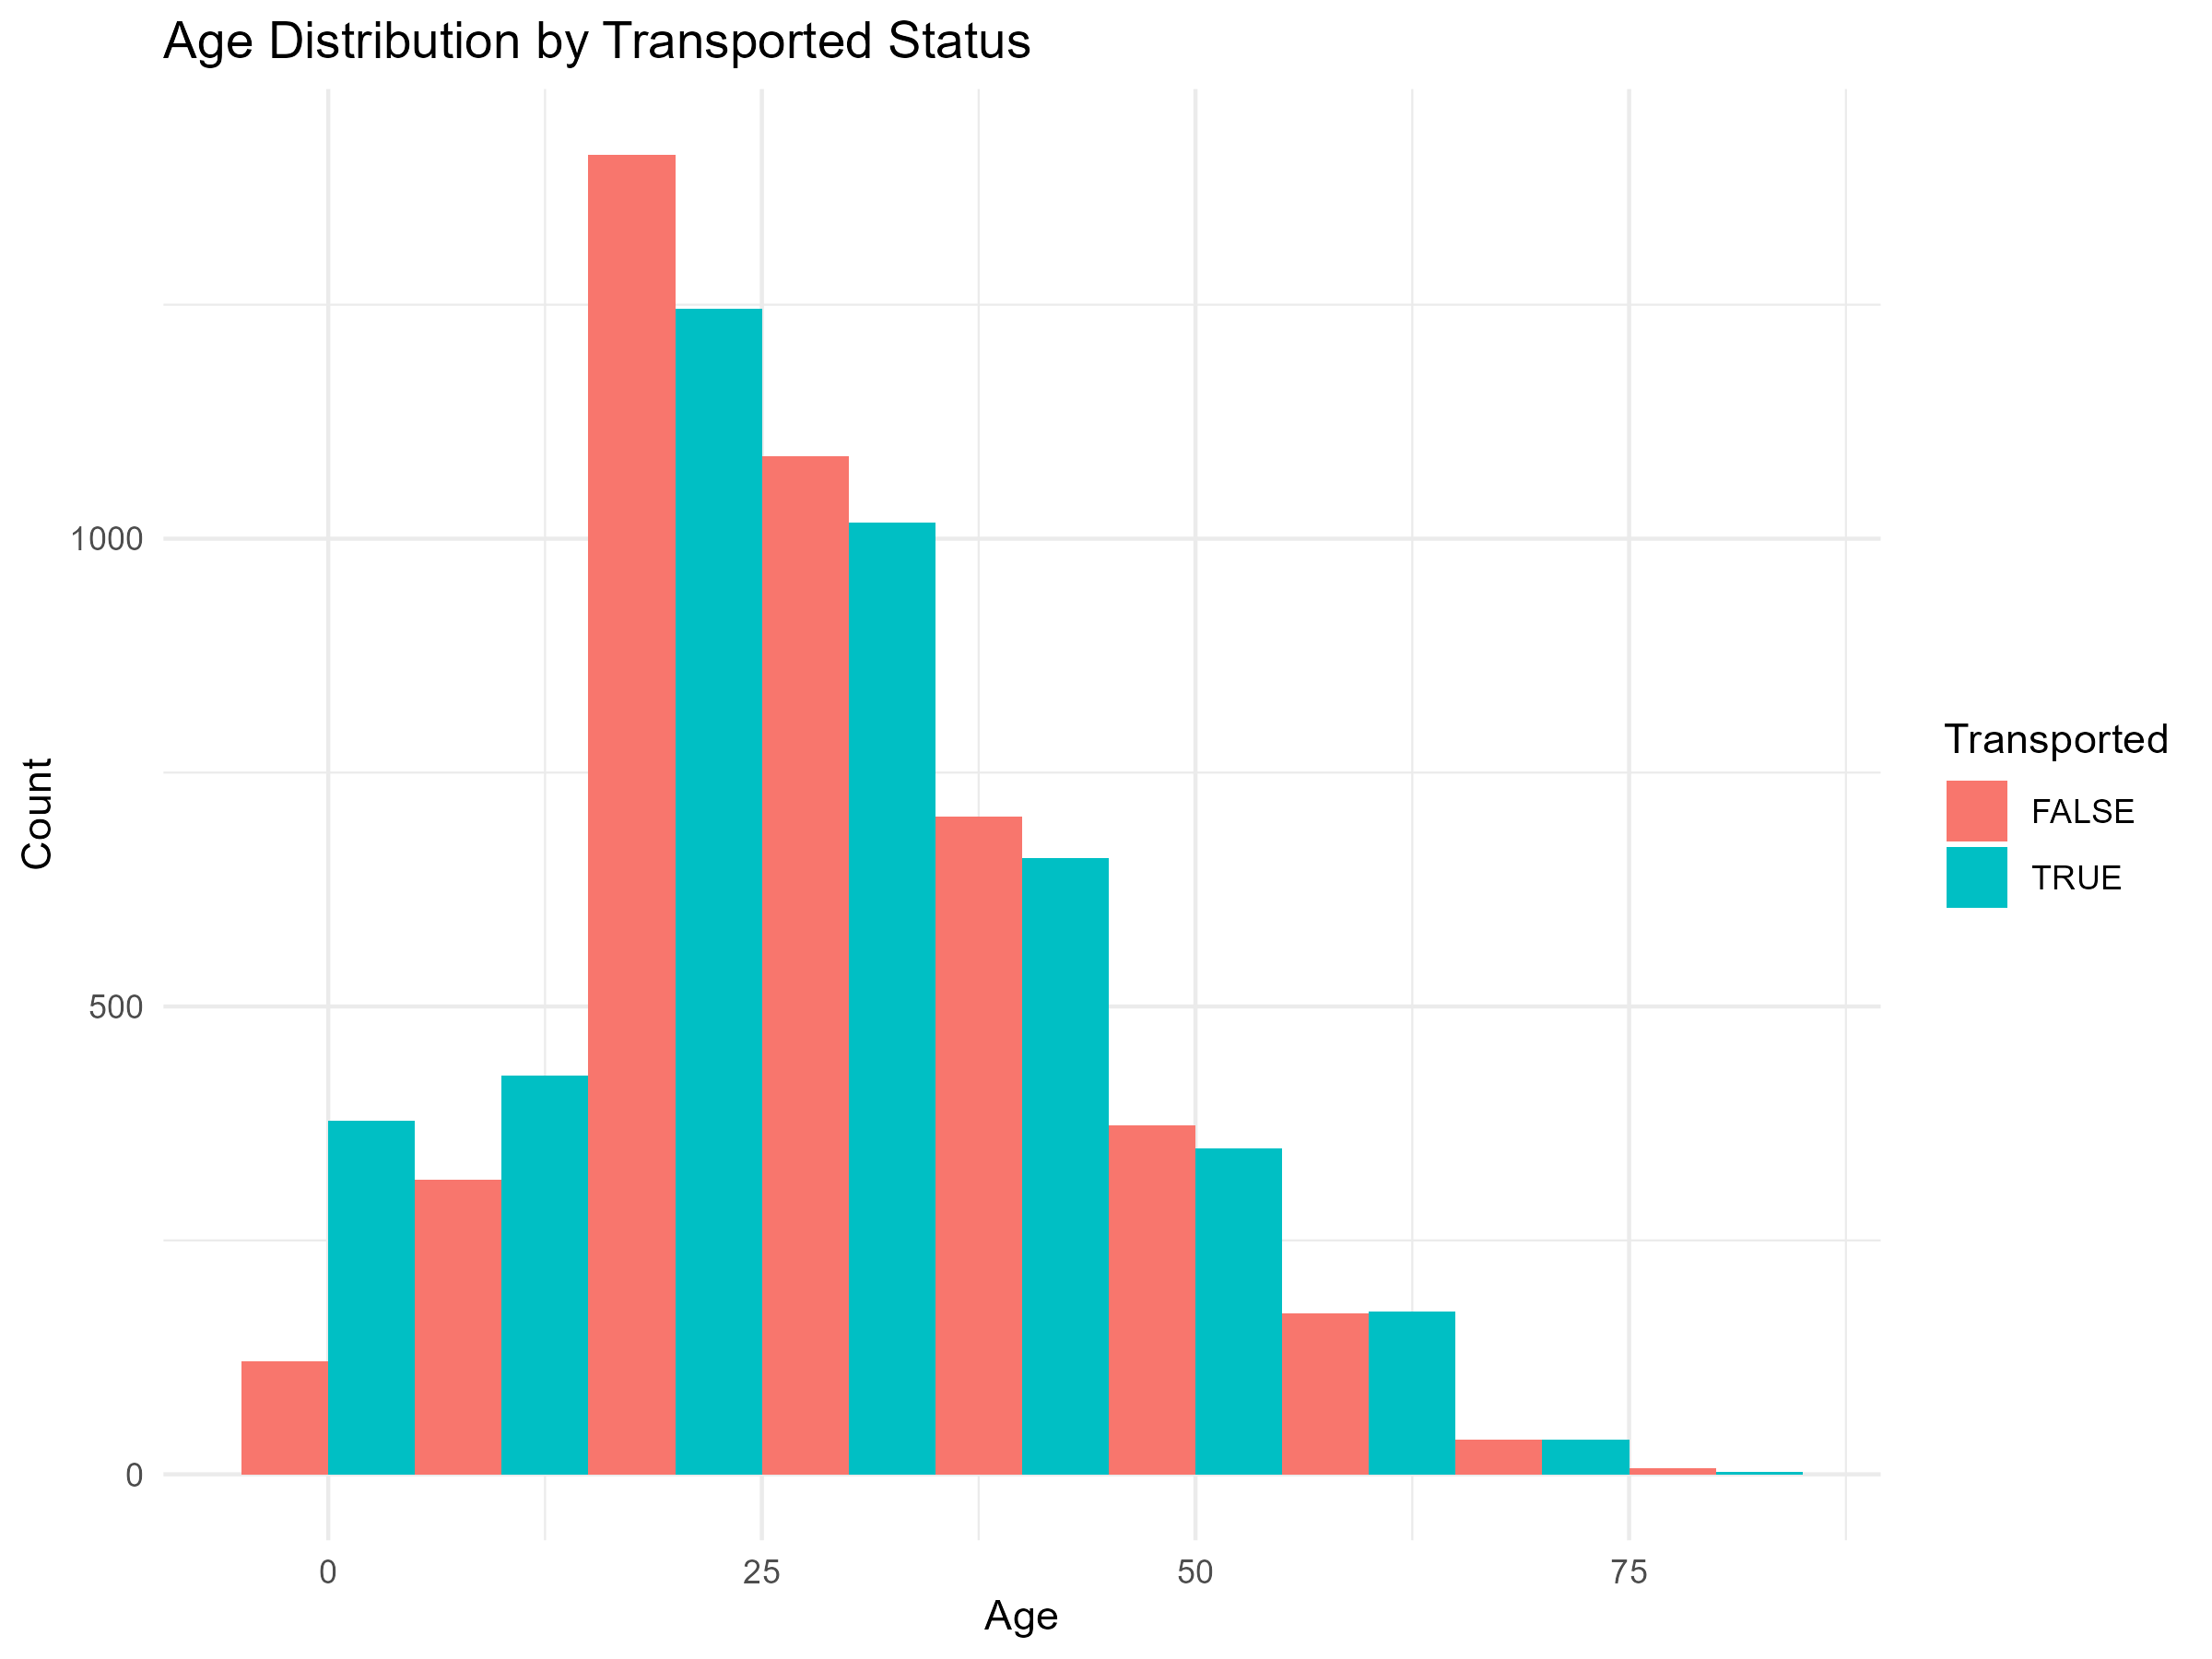
Transported Status
By Age
By HomePlanet
There is no significant difference in transported status across different age groups, indicating that age may not be a strong predictor.
Passengers from Europa seem to have a slightly higher transported rate compared to those from Earth and Mars.

Slide 7
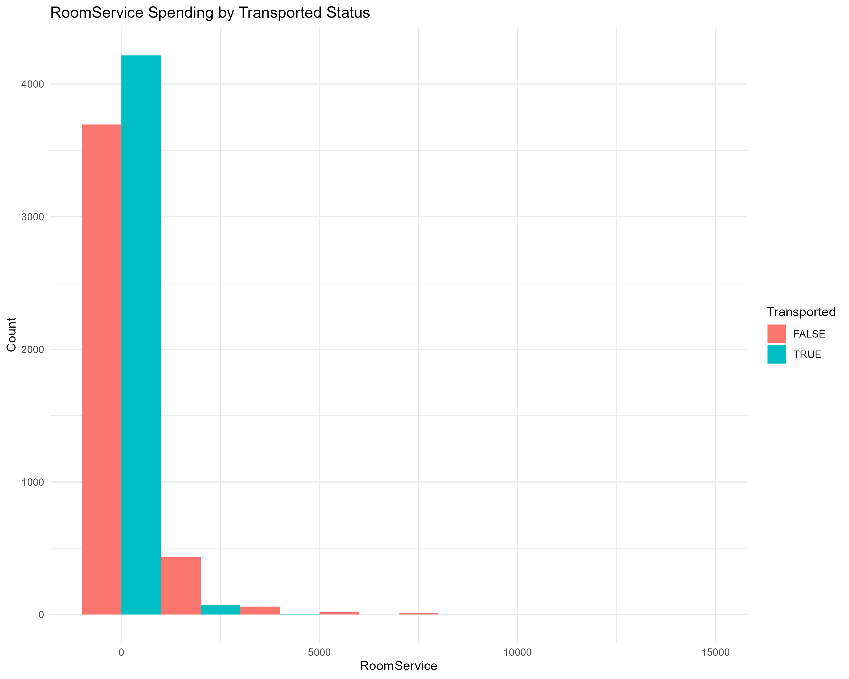
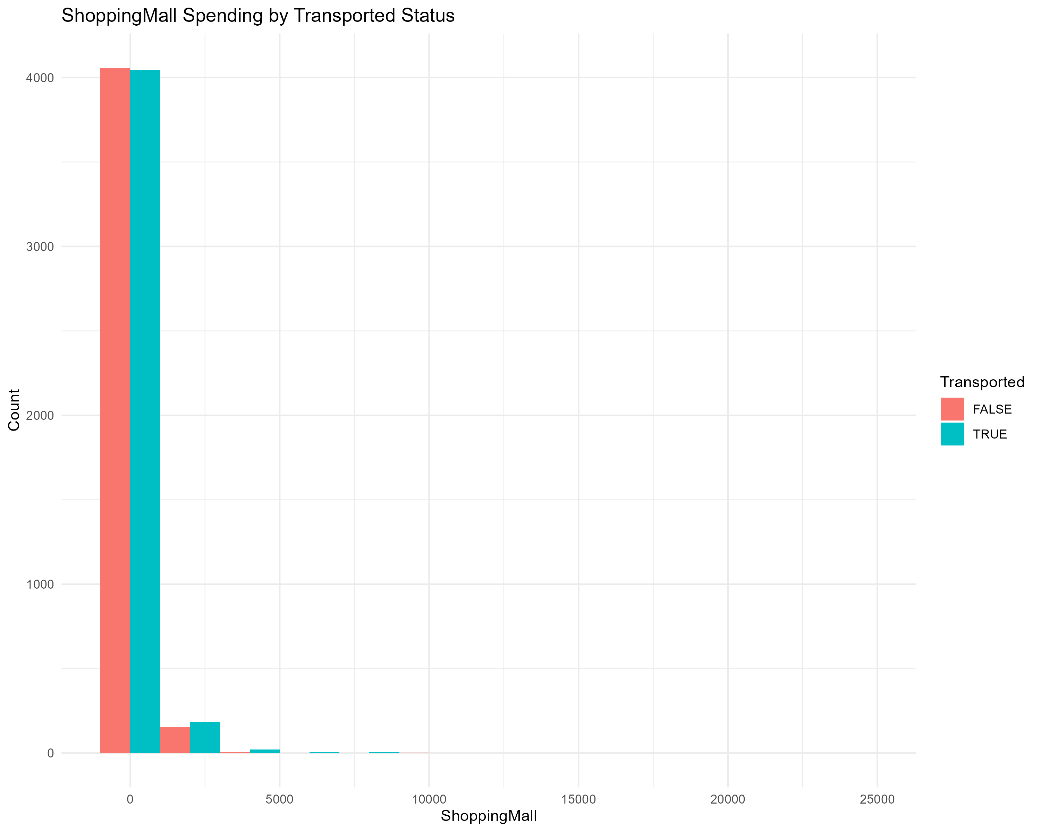
Transported Status by Spending Categories
RoomService
ShoppingMall
Lower spending in ShoppingMall is associated with a higher transported rate.
Passengers who spent less on RoomService had a higher likelihood of being transported.

Slide 8
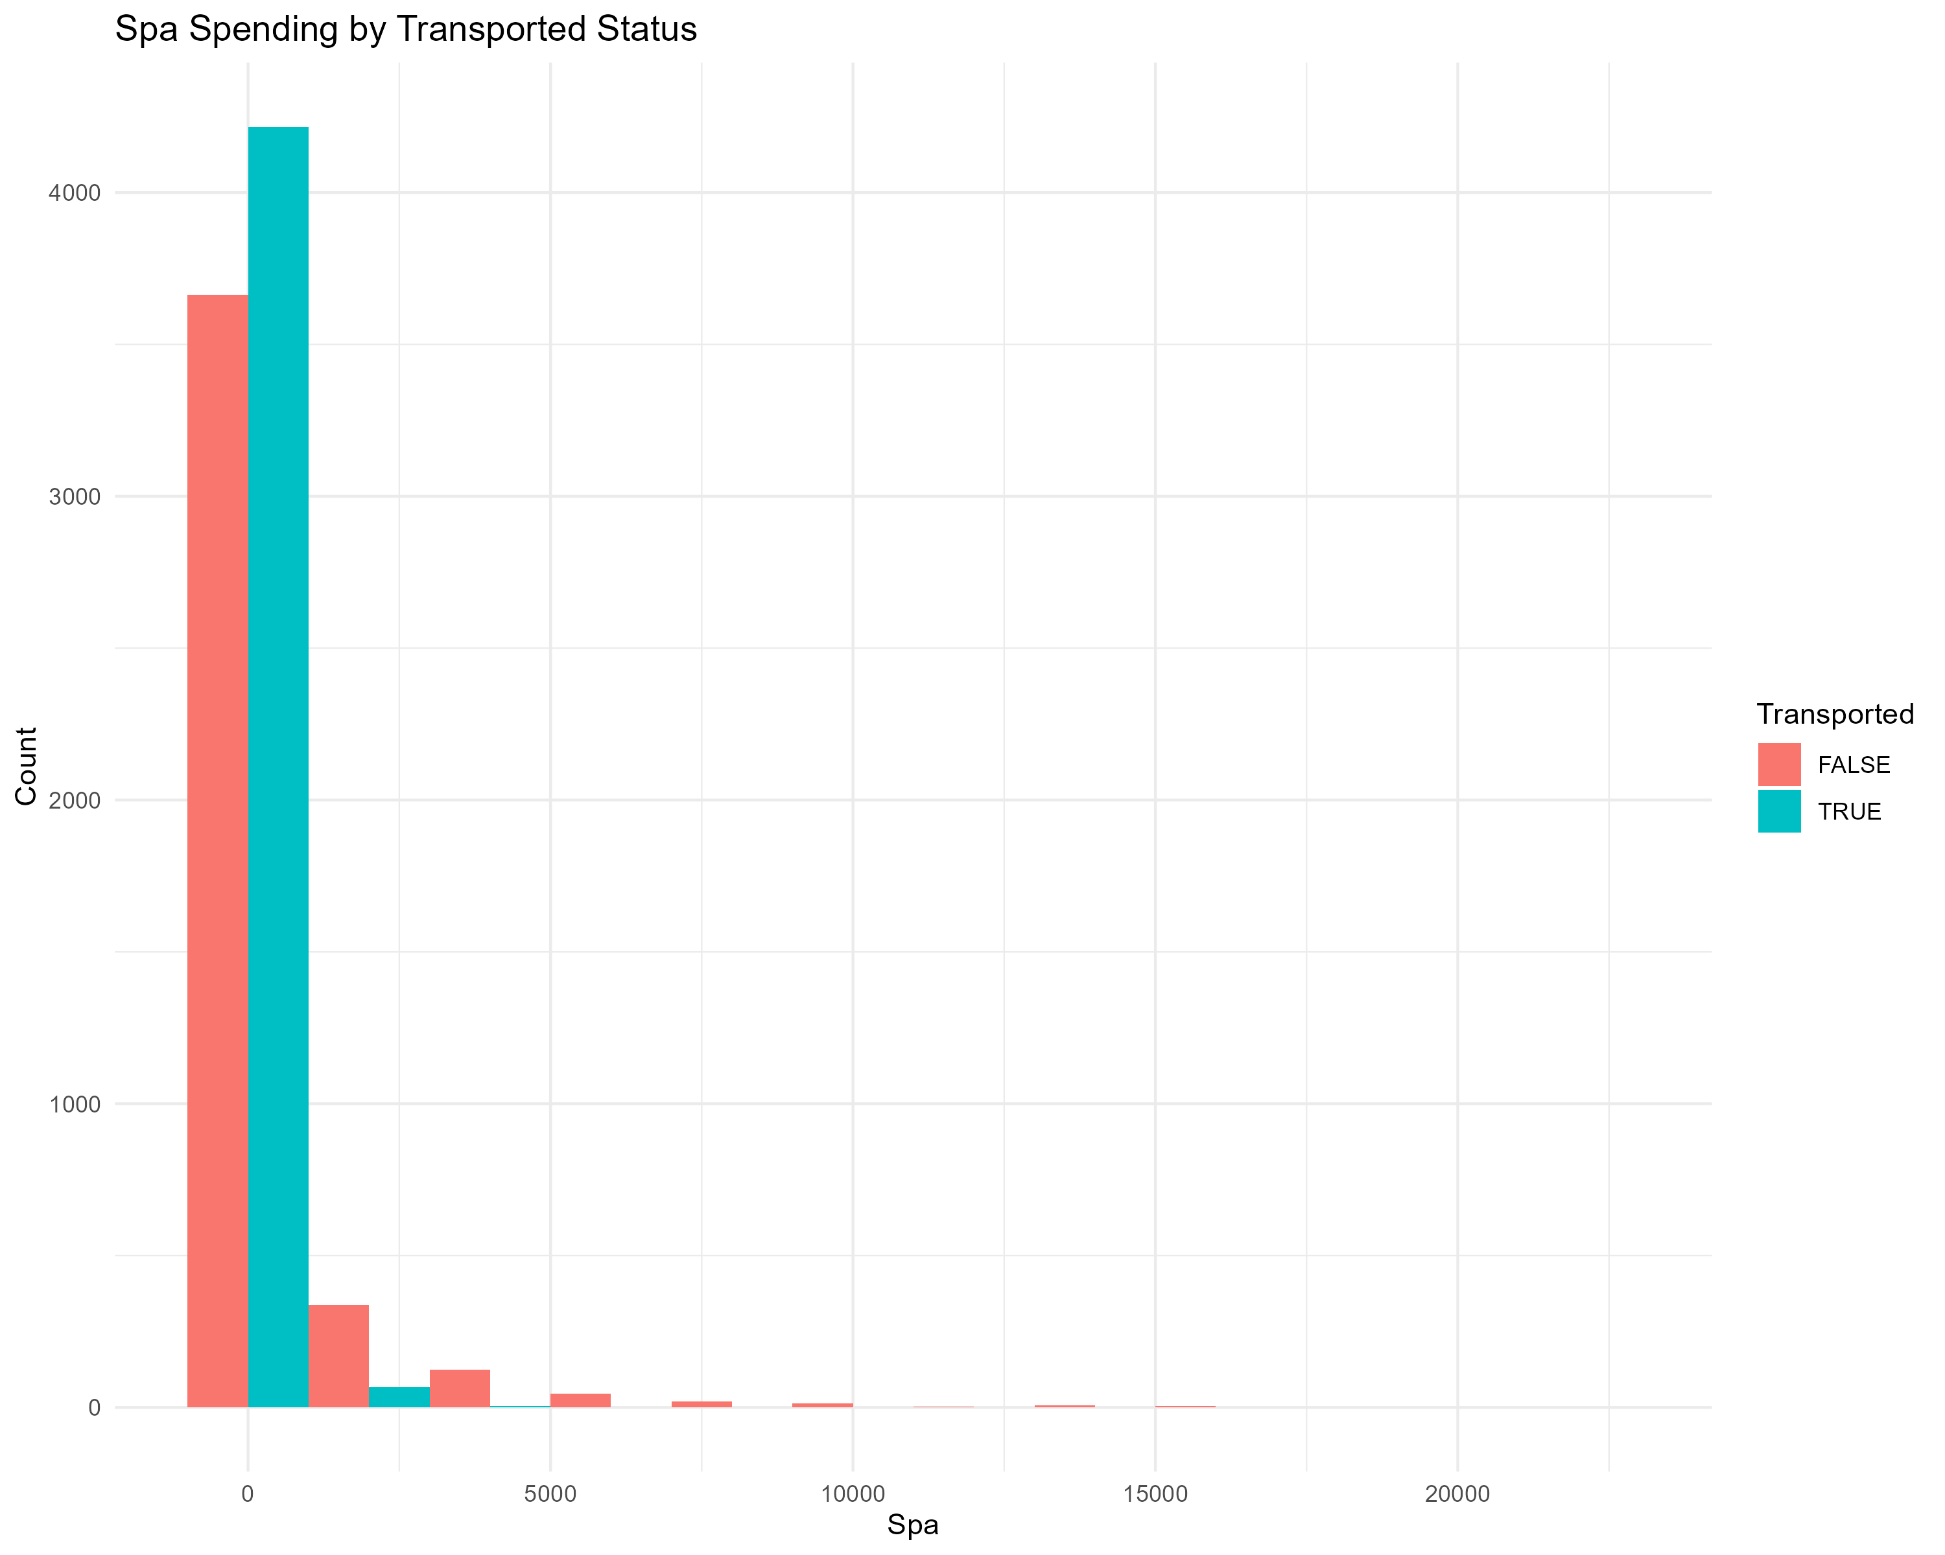

Transported Status by Spending Categories
Spa
VRDeck
Passengers with no spending in Spa had a higher likelihood of being transported.
Lower spending on VRDeck correlates with a higher transported rate.

Slide 9
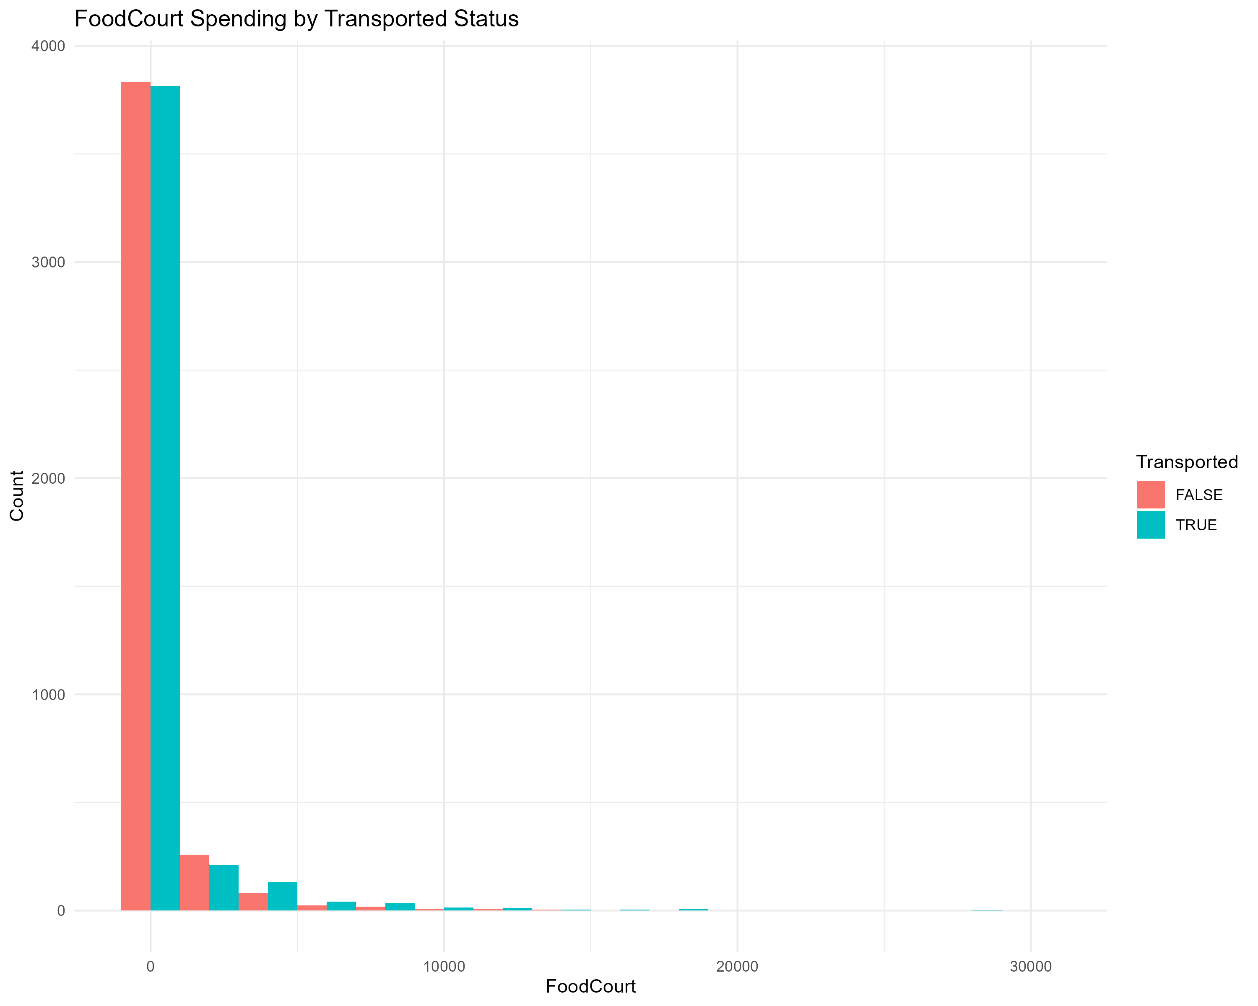
Transported Status by Spending Categories
There is no clear pattern between FoodCourt spending and transported status.

Slide 10
Conclusion
Passengers from Europa had a slightly higher transported rate.
There is no significant correlation between age and transported status.
Lower spending on RoomService, ShoppingMall, Spa, and VRDeck is associated with a higher transported rate.
Spending habits seem to be a significant factor, which could be leveraged in a machine learning model to improve prediction accuracy
Further Analysis: Investigate other potential predictors like CryoSleep, Cabin and VIP status

